Slide 1
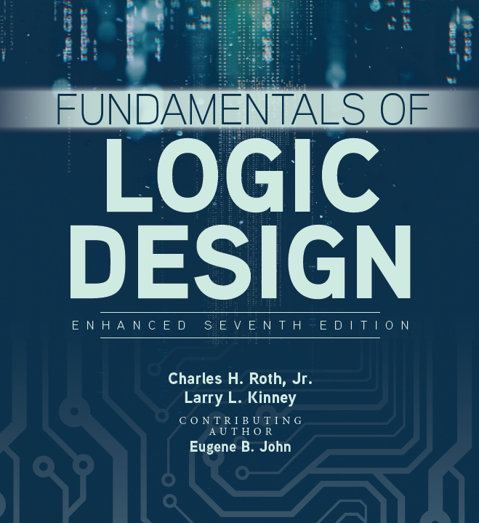

Unit 9
Multiplexers, Decoders, and Programmable Logic Devices

Slide 2
This chapter includes:
9.1 Introduction
9.2 Multiplexers
9.3 Three-State Buffers
9.4 Decoders and Encoders
9.5 Read-Only Memories
9.6 Programmable Logic Devices
9.7 Complex Programmable Logic Devices
9.8 Field-Programmable Gate Arrays

Slide 3
Learning Objectives
1. Explain the function of a multiplexer. Implement a multiplexer using gates.
2. Explain the operation of three-state buffers. Determine the resulting output when three-state buffer outputs are connected together. Use three-state buffers to multiplex signals onto a bus.
3. Explain the operation of a decoder and encoder. Use a decoder with added gates to implement a set of logic functions. Implement a decoder or priority encoder using gates.
4. Explain the operation of a read-only memory (ROM). Use a ROM to implement a set of logic functions.

Slide 4
Learning Objectives
5. Explain the operation of a programmable logic array (PLA). Use a PLA to implement a set of logic functions. Given a PLA table or an internal connection diagram for a PLA, determine the logic functions realized.
6. Explain the operation of a programmable array logic device (PAL). Determine the programming pattern required to realize a set of logic functions with a PAL.
7. Explain the operation of a complex programmable logic device (CPLD) and a field-programmable gate array (FPGA).
8. Use Shannon’s expansion theorem to decompose a switching function.

Slide 5
Introduction
Introduction:
In this unit we introduce the use of more complex integrated circuits (ICs) in logic design.
Integrated circuits may be classified as small-scale integration (SSI), medium-scale integration (MSI), large-scale integration (LSI), or very-large-scale integration (VLSI), depending on the number of gates in each integrated circuit package and the type of function performed.
SSI functions include NAND, NOR, AND, and OR gates, inverters, and flip-flops.

Slide 6
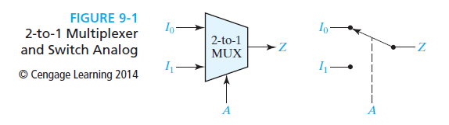
Multiplexers
Multiplexers:
A multiplexer (or data selector, abbreviated as MUX) has a group of data inputs and a group of control inputs.
The control inputs are used to select one of the data inputs and connect it to the output terminal.
A 2-1 MUX and its logic equation are shown below:

Slide 7
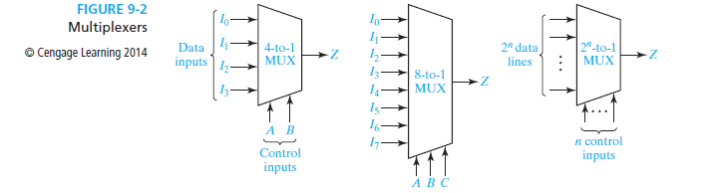


Multiplexers
More Multiplexers:
Logic Equation for 4-1 MUX:
Logic Equation for 8-1 MUX:
Logic Equation for 2^{n}-1 MUX:

Slide 8
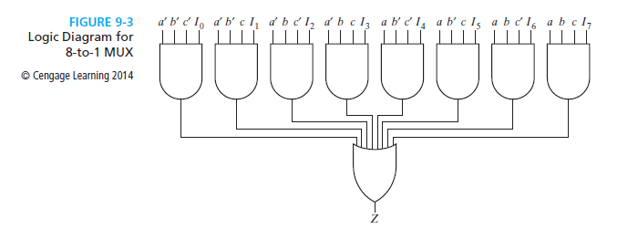
Multiplexers
Logic Diagram for 8-to-1 MUX:

Slide 9

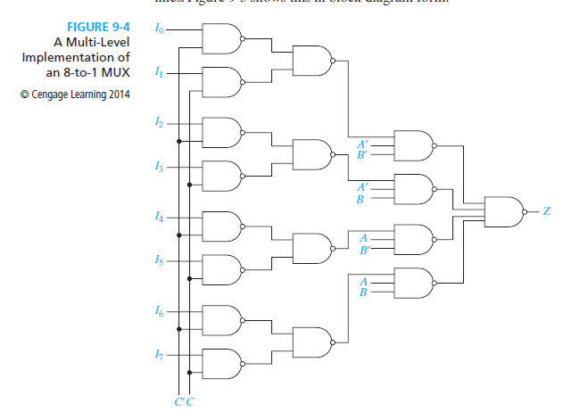
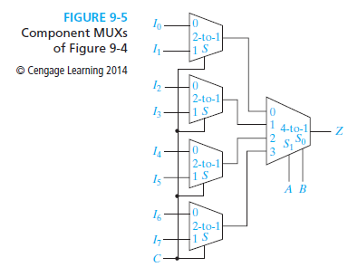
Multiplexers
8-to-1 MUX NAND Implementation:
NAND Logic Equation from Factoring Equation 9-2:

Slide 10
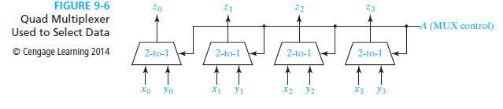
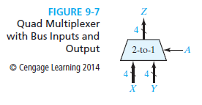
Multiplexers
Quad Multiplexers to Select Data:
Multiplexers are often used to select data which is to be processed or stored in digital system design.

Slide 11
Multiplexers
Enable:
Another type of multiplexer has an additional input called an enable.
The 8-to-1 MUX in Figure 9-3 can be modified to include an enable by changing the AND gates to five-input gates.
The enable signal E is connected to the fifth input of each of the AND gates.
Then, if E = 0, Z = 0 independent of the gate inputs Ii and the select inputs a, b, and c. However, if E = 1, then the MUX functions as an ordinary 8-to-1 multiplexer.

Slide 12
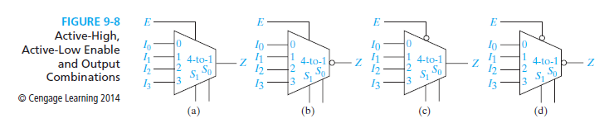
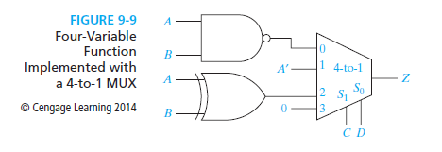
Multiplexers
4-1 Multiplexer Combinations and Implemented Functions:

Slide 13
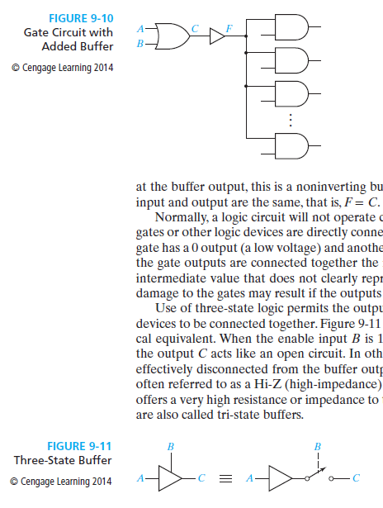
Three-State Buffers
Buffers:
A gate output can only be connected to a limited number of other device inputs without degrading the digital system’s performance.
A simple buffer may be used to increase the driving capability of a gate output. Figure 9-10 shows a buffer connected between a gate output and several gate inputs. Because no bubble is present

Slide 14
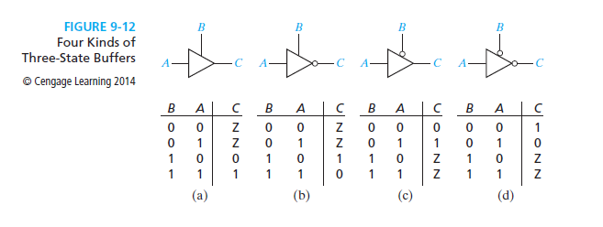
Three-State Buffers
Four Kinds of Three State- Buffers:

Slide 15
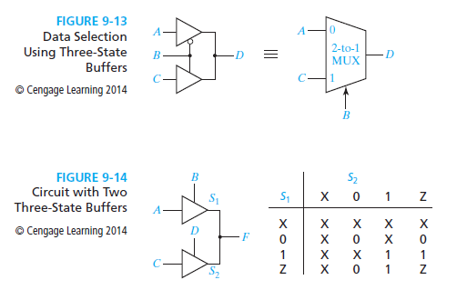
Three-State Buffers
Data Selection and Circuits with Three-State Buffers:

Slide 16
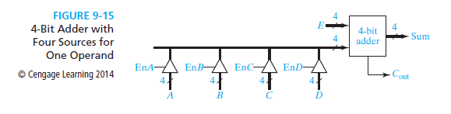
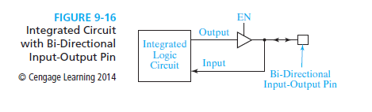
Three-State Buffers
4-Bit Adder and Bidirectional Input-Outputs:
Bi-directional means that the same pin can be used as an input pin and as an output pin, but not both at the same time.

Slide 17
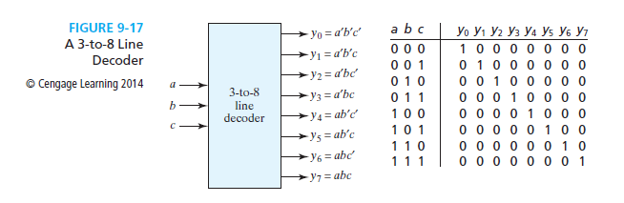
Decoders and Encoders
3-8 Decoder Block Diagram and Truth Table:

Slide 18
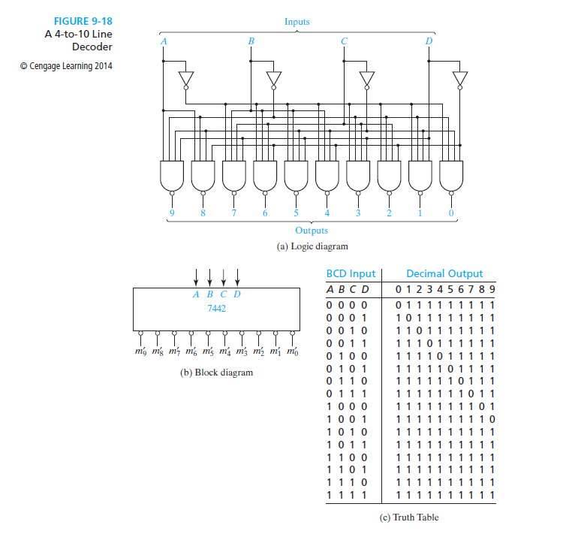
Decoders and Encoders
4-10 Line Decoder Logic Diagram:

Slide 19
Decoders and Encoders
4-10 Decoder Block Diagram and Truth Table:

Slide 20
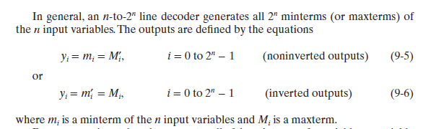
Decoders and Encoders
General Line Decoder Output Equations:

Slide 21
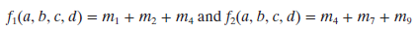
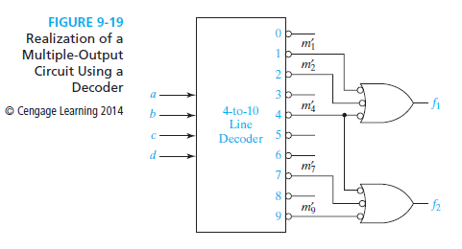
Decoders and Encoders
Realization of Functions Using Decoders:
For functions f1 and f2:

Slide 22
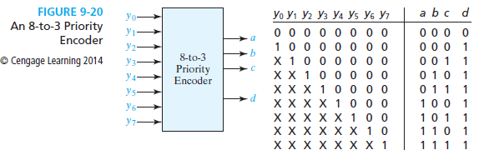
Decoders and Encoders
Encoders:
Encoders have the inverse function of decoders.

Slide 23
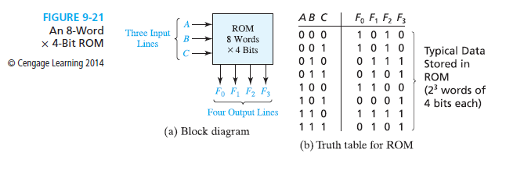
Read-Only Memories
Read-Only Memory:
A read-only memory (ROM) consists of an array of semiconductor devices that are interconnected to store an array of binary data.
Once binary data is stored in the ROM, it can be read out whenever desired, but the data that is stored cannot be changed under normal operating conditions.

Slide 24
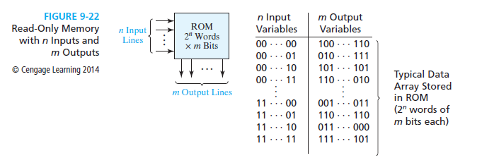
Read-Only Memories
ROM with n-inputs and m-outputs:
A ROM which has n input lines and m output lines (Figure 9-22) contains an array of 2^{n} words, and each word is m bits long. The input lines serve as an address to select one of the 2^{n} words.
When an input combination is applied to the ROM, the pattern of 0’s and 1’s which is stored in the corresponding word in the memory appears at the output lines.
A 2^{n × m} ROM can realize m functions of n variables because it can store a truth table with 2^{n} rows and m columns.

Slide 25
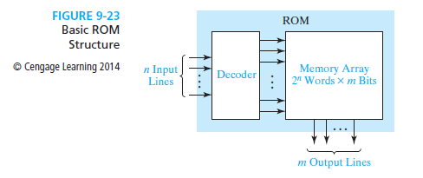
Read-Only Memories
Basic ROM Structure:
A ROM basically consists of a decoder and a memory array, as shown in Figure 9-23.
When a pattern of n 0’s and 1’s is applied to the decoder inputs, exactly one of the 2^{n} decoder outputs is 1.
This decoder output line selects one of the words in the memory array, and the bit pattern stored in this word is transferred to the memory output lines.

Slide 26
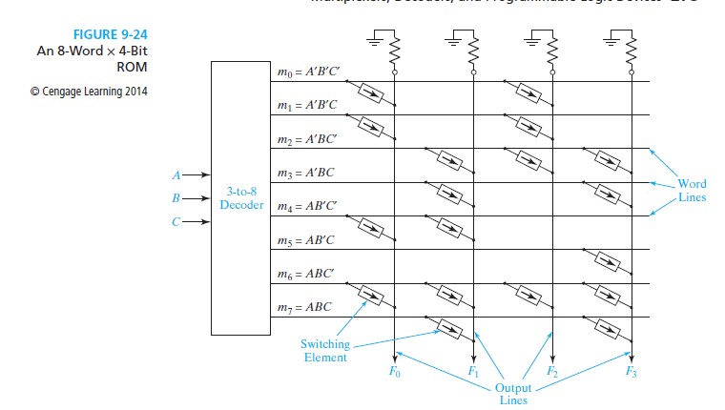
Read-Only Memories
8-Word x 4-Bit ROM:

Slide 27


Read-Only Memories
8-Word by 4-Bit ROM Functions:

Slide 28
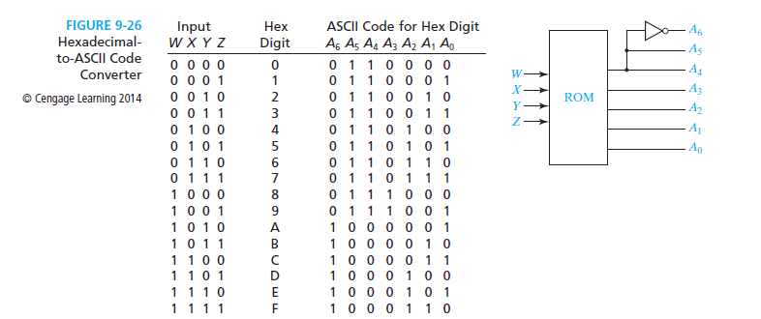
Read-Only Memories
Hexadecimal-to-ASCII Code Converter:

Slide 29
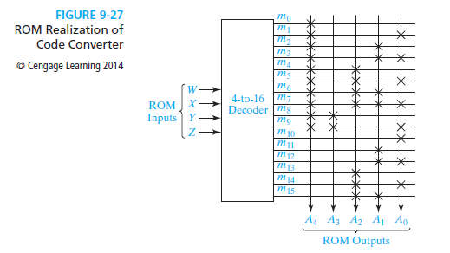
Read-Only Memories
ROM Realization of Code Converter:

Slide 30
Programmable Logic Devices
A programmable logic device (or PLD) is a general name for a digital integrated circuit capable of being programmed to provide a variety of different logic functions
In this chapter we will study:
    Combinational PLDs
    Sequential PLDs

Slide 31
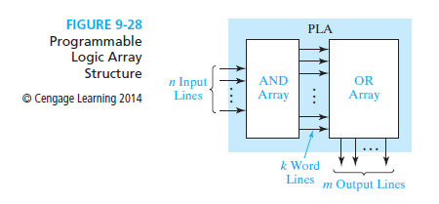
Programmable Logic Devices
Programmable Logic Arrays (PLA):
A PLA performs the same basic function as a ROM.
A PLA with n inputs and m outputs (Figure 9-28) can realize m functions of n variables.

Slide 32
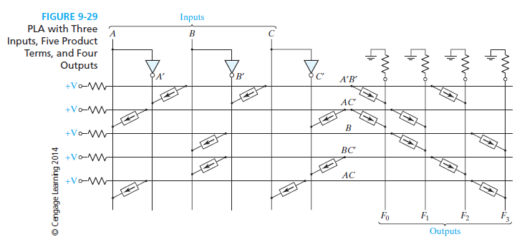
Programmable Logic Devices

Slide 33
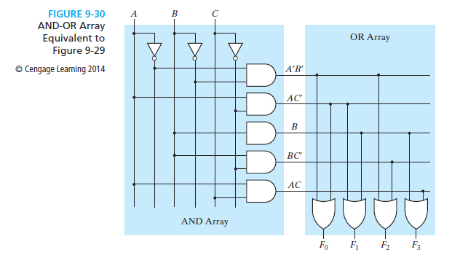
Programmable Logic Devices

Slide 34
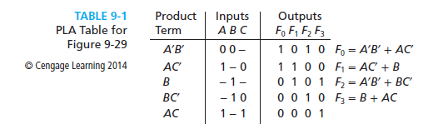
Programmable Logic Devices
PLA Tables:
The symbols 0, l, and – indicate whether a variable is complemented, not complemented, or not present in the corresponding product term.
The output side of the table specifies which product terms appear in each output function.
A 1 or 0 indicates whether a given product term is present or not present in the corresponding output function.

Slide 35
Programmable Logic Devices
PLA Tables and ROM Truth Tables:
In a ROM truth table each row represents a minterm; therefore, exactly one row will be selected by each combination of input values.
The 0’s and 1’s of the output portion of the selected row determine the corresponding output values.
On the other hand, each row in a PLA table represents a general product term. Therefore, zero, one, or more rows may be selected by each combination of input values.
To determine the value of fi for a given input combination, the values of fi in the selected rows of the PLA table must be ORed together.

Slide 36
Programmable Logic Devices
Programmable Array Logic (PAL):
The PAL (programmable array logic) is a special case of the programmable logic array in which the AND array is programmable and the OR array is fixed
PAL has same structure as PLA in Figure 9-28.

Slide 37
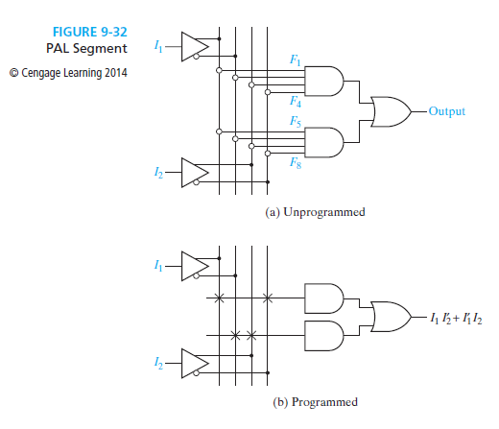
Programmable Logic Devices

Slide 38
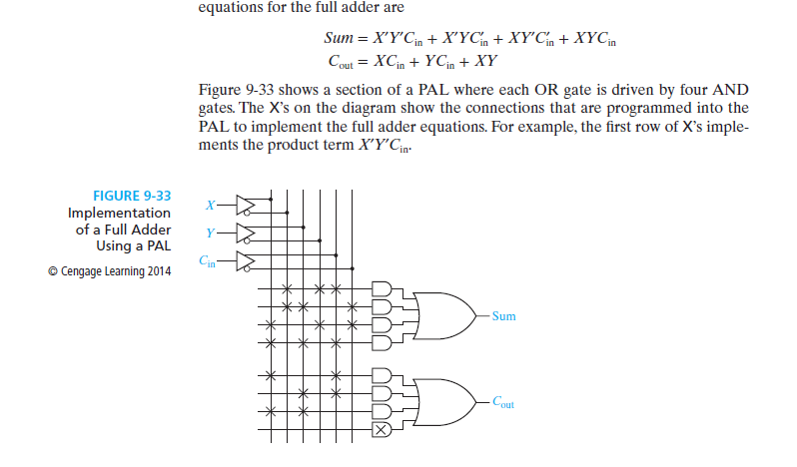
Programmable Logic Devices
Implementing a Full Adder Using PAL:

Slide 39
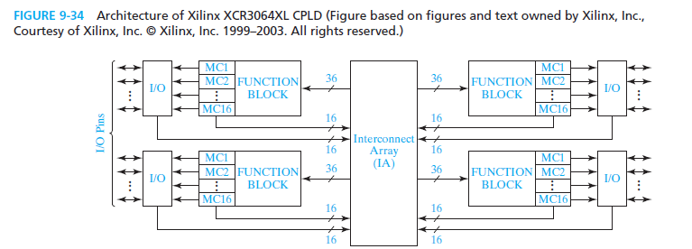
Complex Programmable Logic Devices
Complex Programmable Logic Devices (CPLD):
Instead of a single PAL or PLA on a chip, many PALs or PLAs can be placed on a single CPLD chip and interconnected.

Slide 40
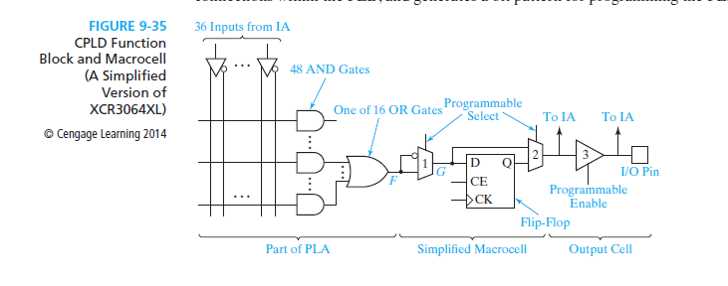
Complex Programmable Logic Devices
Figure 9-35 shows how a signal generated in the PLA is routed to an I/O pin through a macrocell.

Slide 41
Field-Programmable Arrays
Field-Programmable Gate Arrays (FPGA):
An FPGA is an IC that contains an array of identical logic cells with programmable interconnections.
The user can program the functions realized by each logic cell and the connections between the cells.
The interior consists of an array of logic cells, also called configurable logic blocks (CLBs).
The array of CLBs is surrounded by a ring of input-output interface blocks. These I/O blocks connect the CLB signals to IC pins.
The space between the CLBs is used to route connections between the CLB outputs and inputs.

Slide 42
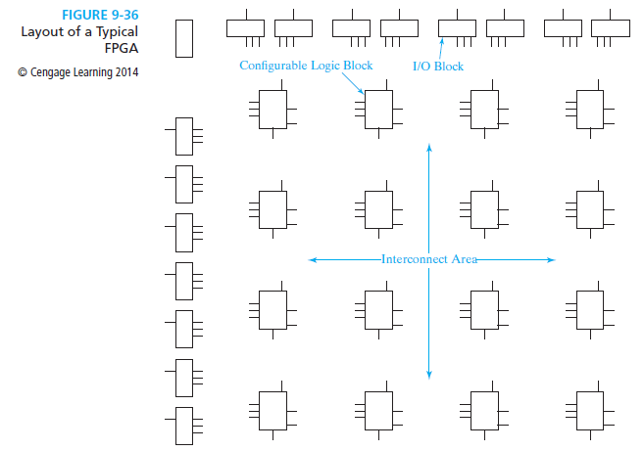
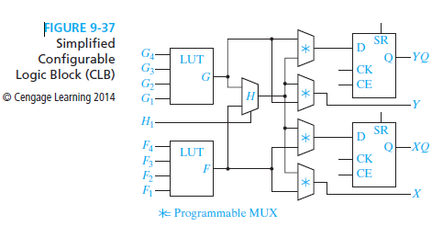
Field-Programmable Arrays
FPGAs and CLBs:

Slide 43
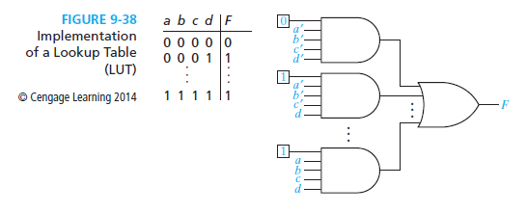
Field-Programmable Arrays
Implementing a Function Generator with Inputs a,b,c,d:
The numbers in the squares represent the bits stored in the LUT. These bits enable particular minterms.
Because the function being implemented is stored as a truth table, a function with only one minterm or with as many as 15 minterms requires a single function generator.

Slide 44
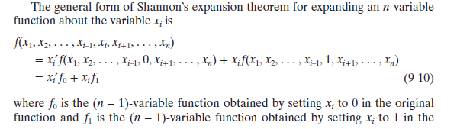
Field-Programmable Arrays
Decomposition of Switching Functions:
One method of decomposition is Shannon’s Expansion Theorem.

Slide 45
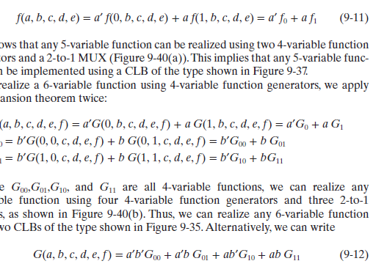
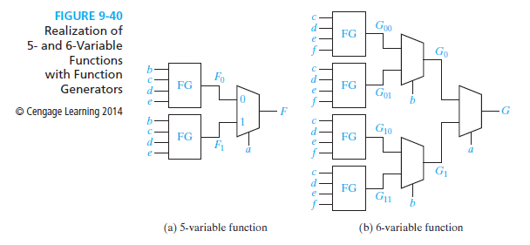
Field-Programmable Arrays
Realization of 5- and 6- Variable Functions:

